Slide 1

National Institute of Technology Delhi
End Semester Presentation
Machine Learning for Resource classification on the basis of user role

Slide 2

Early Days / Present Days
Resource Administrator
Employees

Slide 3

Our Aim for Future
Resources allocated automatically

Slide 4
Problem Statement
The aim of the project is to design a classifier that can classify whether a resource(file) can be accessed by a particular employee role.
Using the training data of employee roles and their provisioned access, models can be built that automatically determine access privileges as employees may enter or leave roles within a company. These auto-access models seek to minimize the human involvement required to grant or revoke employee access.

Slide 5

Information Extracted On Data Digging
PROBLEM 1.) There are two files of data:
Train.csv – Sample Count 32769
Test.csv -- Sample Count 58922
In the train set there are 30872 instances in class 1 (Majority Class) and 1897 instances in class 0 (Minority Class)

Slide 6
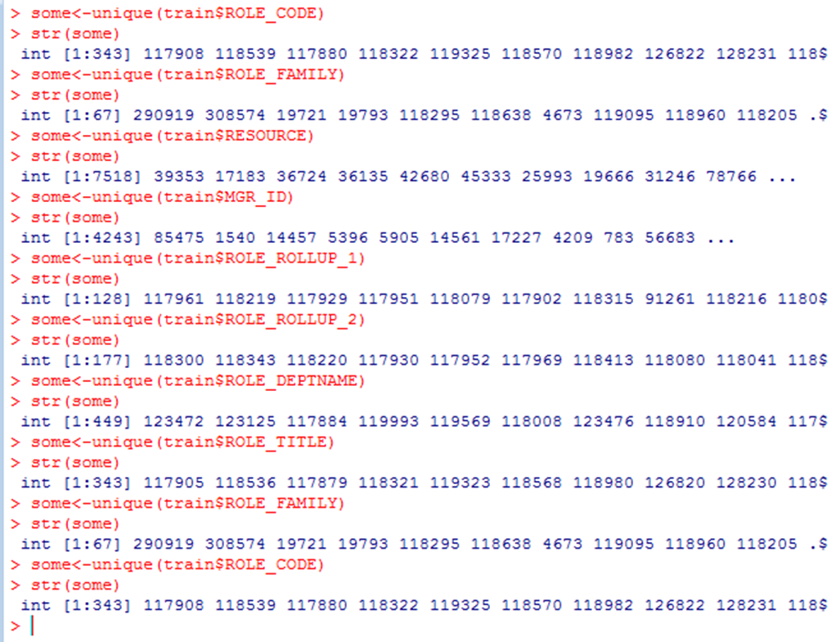
Information Extracted On Data Digging
Problem 2.) The type of every feature is categorical, but there are large number of categories for each feature:

Slide 7
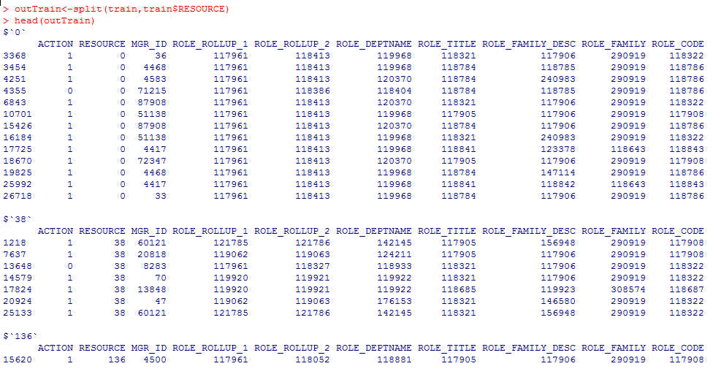
Information Extracted On Data Digging
3.) There are 7518 unique resources each having one or more instances of employee role.

Slide 8
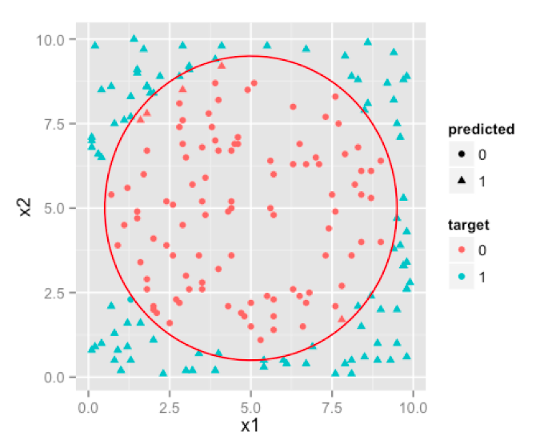
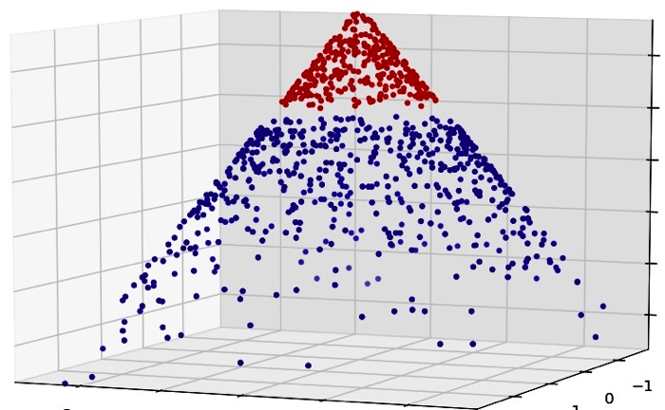
Prediction Model Used: Support Vector Machine Classification
Motivation
While researching about the problem , we realized an analogy of the problem with the allocation of resources over a cloud system. The Cloud has to continuously make decisions about resource allocation on time and performance factors etc. A research paper suggested doing this by Machine Learning by using Support Vector Regression.
SVM

Slide 9
Introduction of Weights in Data
A major problem in our dataset was Data inconsistency i.e. presence of huge data of class “1” (94%) but very less data of class “0” (6%).
SVM
To solve this problem we needed to assign weights to the classes accordingly. This led us to obtain normalized data for SVM classification resulting to a significant increase in the accuracy of classification.
DECISION TREE
In Decision Tree classification we used the SMOTE(Synthetic Minority Oversampling Technique) utility to balance our sample train set.
On running the Decision Tree algorithm (rpart) we obtained an accuracy similar to the SVM model.

Slide 10
Further to increase the accuracy of classification, we moved over to feature extraction.
In feature extraction we try to identify the features that contribute the most in classification.
This may help by avoiding the features that doesn’t contribute to classification accuracy, and rather deteriorate it.
Feature Extraction

Slide 11
The contribution of each feature in the classification is shown in the following table:
Feature | Contribution In Classification (%)
RESOURCE | 5.808
MGR_ID | 8.09
ROLE_ROLLUP_1 | 8.5
ROLE_ROLLUP_2 | 5.82
DEPTNAME | 7.14
ROLE_TITLE | 5.45
ROLE_FAMILY_DESC | 5.45
ROLE_FAMILY | 5.4
ROLE_CODE | 6.1
Here we see that all the features have very small amount of individual contribution to classification accuracy, so feature selection and extraction for SVM algorithm seems futile.

Slide 12
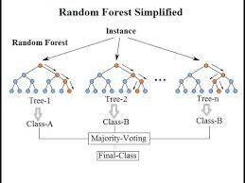
Future Lookout
After completing SVM model for classification, we intend to move on from the
Linear models to Ensemble models
where we’ll be trying to integrate the prediction/classification models for better accuracy.
Some of the Ensemble methods we intend to use:
Random Forest

Slide 13
Thank You

